Slide 1


The Effects
of Technology
on Learning
01
A school project presented by Group A

Slide 2

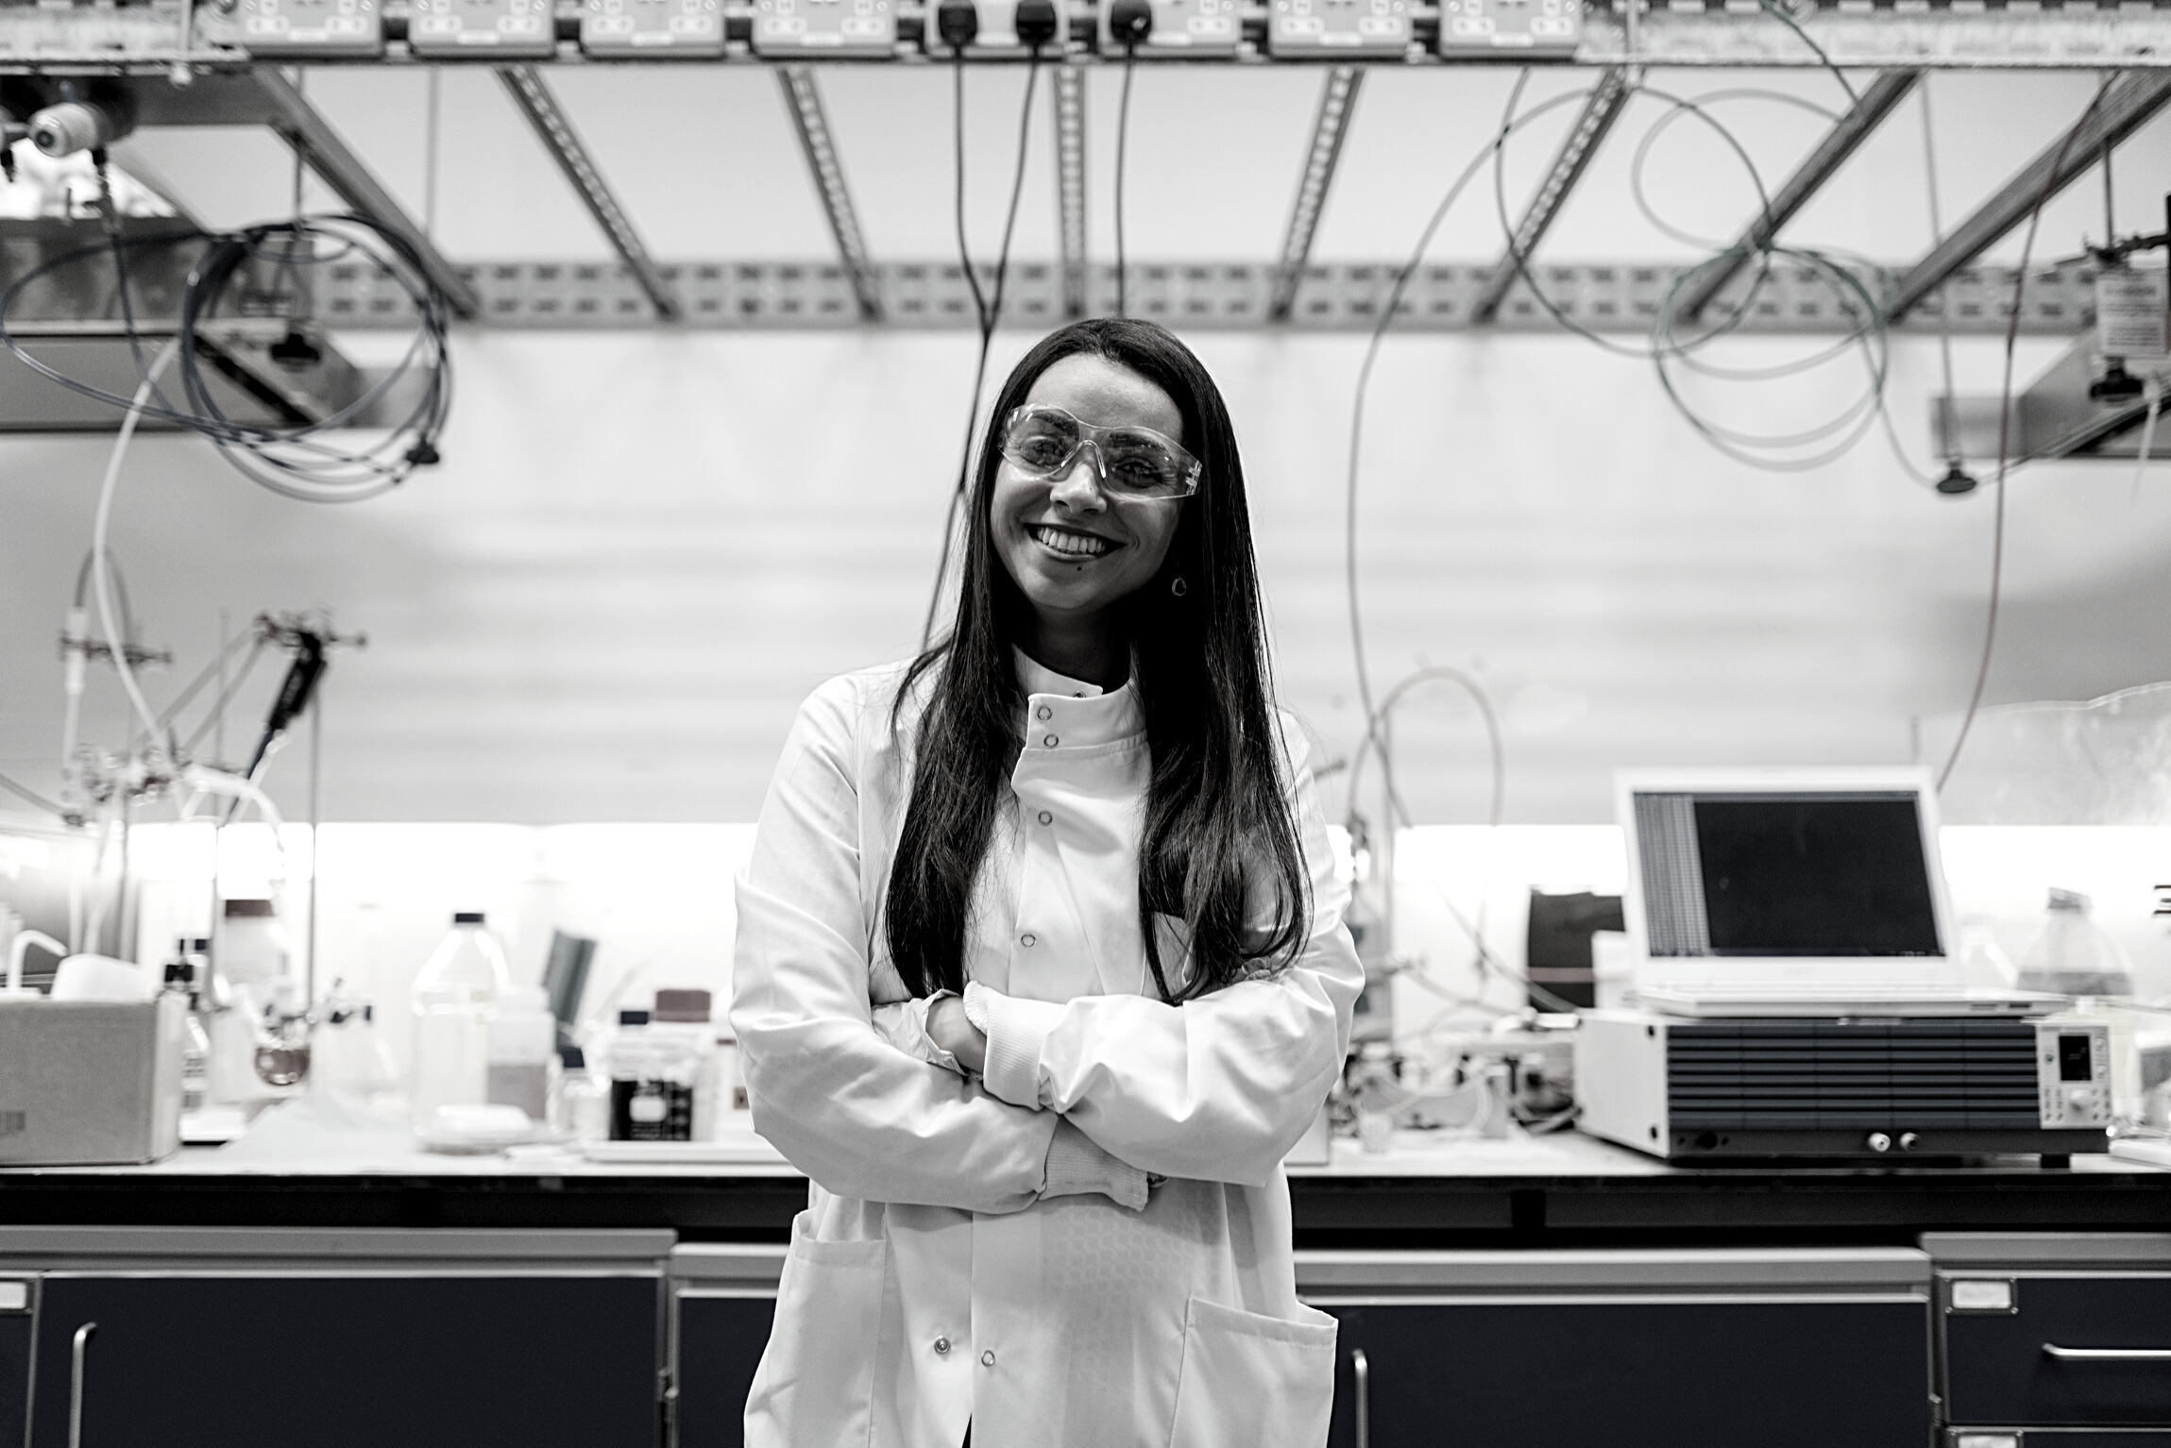

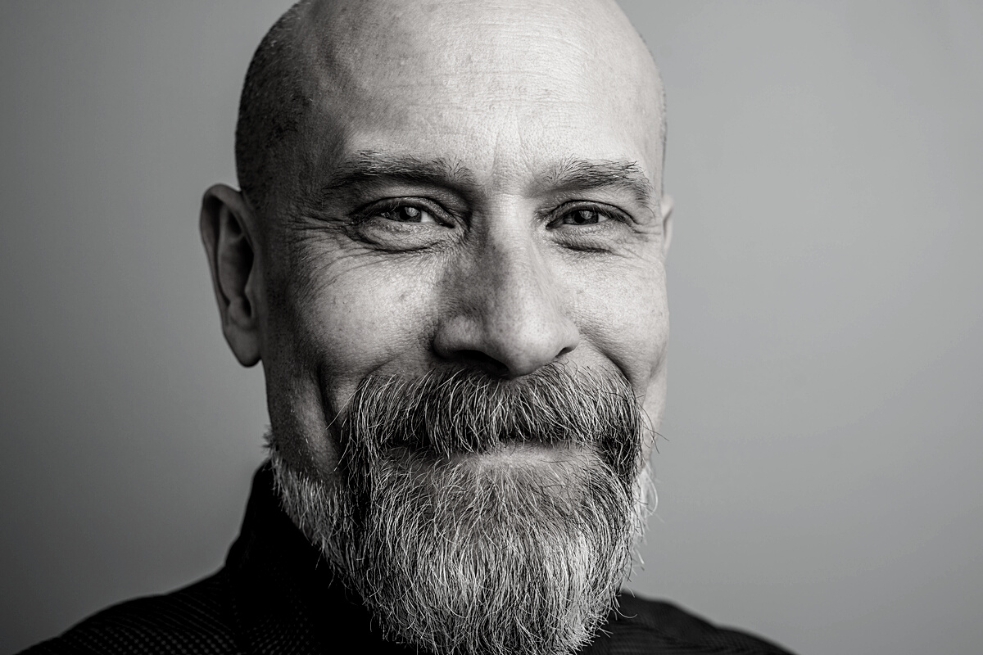
Group Members
Group 1A
02
Lucky Perez
Janna Patterson
Elvis Radisson
Scientist and
Researcher
Scientist and Encoder
Statistician

Slide 3

Introduction
03
Part 01

